Slide 1


Slide 2

Objective
Why?
Conventional method of Q-learning require large amount of data and high computational cost. Can we leverage mathematical knowledge to reduce the data requirement and training time?
What?
Reducing training time and data requirement in Q-learning for control problems.
How?
To do so we will combine control-tutored policy with the conventional Q-learning policy.

Slide 3
Machine Learning and its types
Machine learning is an application of artificial intelligence (AI) that enables systems to automatically learn and improve from experience without explicit programming
Machine Learning
Supervised Learning
Unsupervised Learning
Reinforcement Learning
Both Target and Feature available
Only Feature available
Learning using feedback
(Interaction Data)

Slide 4
What is Reinforcement Learning?
Type of machine learning that trains an ‘agent’ through trial & error interactions with an environment
Agent
Try
Reward
Reward

Slide 5
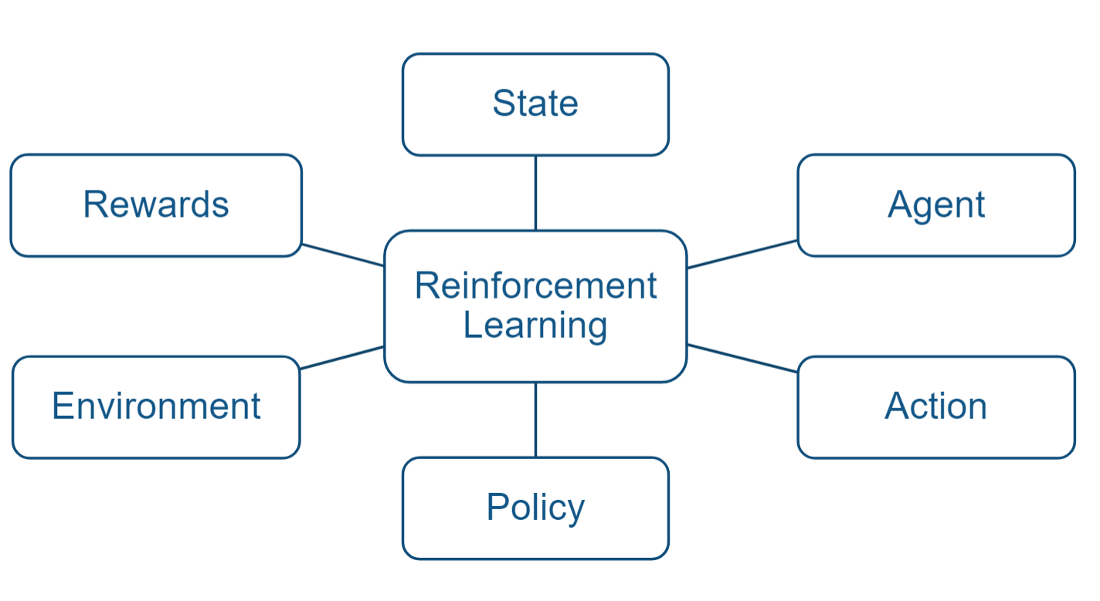
Some Key Concepts

Slide 6
Some Key Concepts Ft. Self Driving Car
Agent
Vehicle’s computer learns how to drive
State
Velocity, Position of car using sensor readings from LIDAR, cameras,…
Environment
Represent road conditions, vehicle position
Action
Generating steering, braking, throttle commands,...
Policy
Internal state-to-action mapping...
Reward
that tries to optimize, e.g., lap time & fuel efficiency
The policy is updated through repeated trial-and-error by a reinforcement learning algorithm

Slide 7
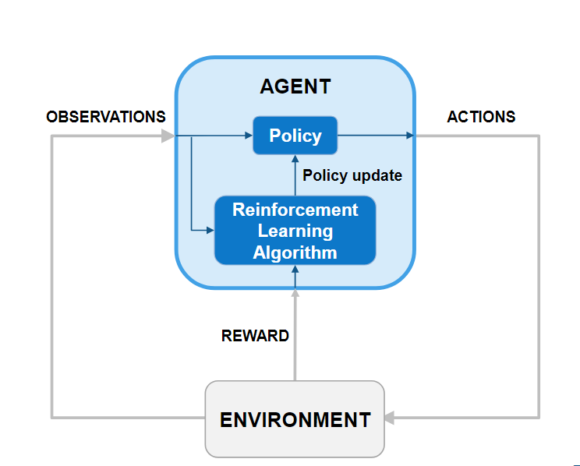
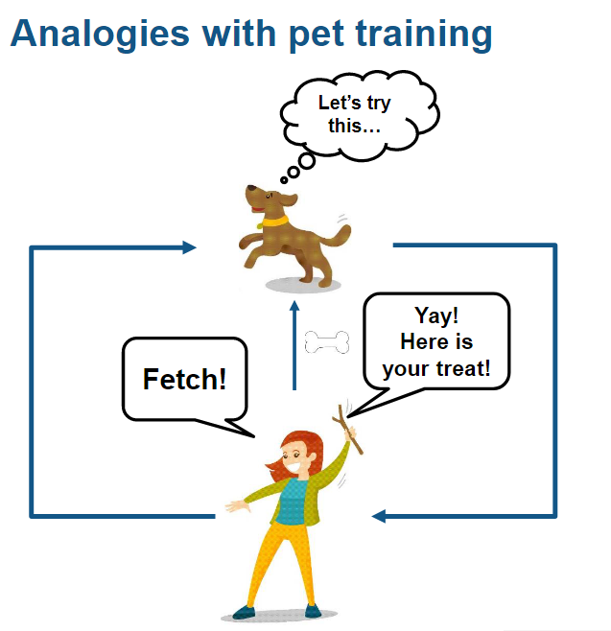
How Reinforcement Learning Works?
It learns through trial and error

Slide 8
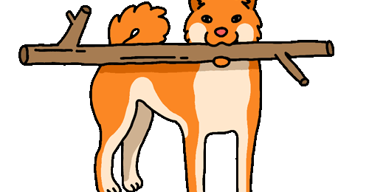
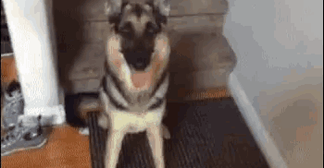
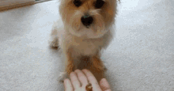
How to train your dog?
Success
Failure
Reward
The dog successfully return the object thrown i.e. goal accomplished
Episode Terminate
The dog encountered a failure i.e. reached an undesirable state
Episode Terminate
After completion of task we give him reward
Reward

Slide 9
Q Learning
It provides agents with the capability of learning to act optimally in Markovian domains by experiencing the consequences of actions, without requiring them to build maps of the domains.
(Watkins, 1989)
The Markov property states that the conditional probability distribution for the system at the next step (and in fact at all future steps) depends only on the current state of the system

Slide 10
Q-Learning
Policy
Action = F(State observations)
Model Free Reinforcement Learning
Value-Based Reinforcement Learning i.e. we need a value-table (Q-Table)
Observation or State Space: Continuous/Discrete
Action Space: Discrete
Q-Table

Slide 11
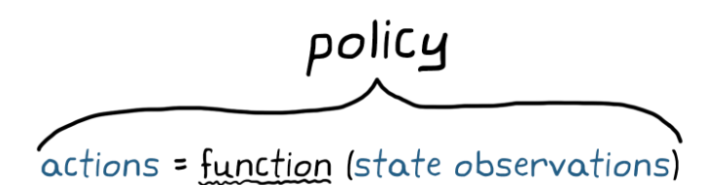
Policy
Policy is a function made up of tuneable parameters
There is a set of parameters that produces the optimal policy
For Q-learning the final policy is the Q-table after training
Our final goal is to find the optimal policy that gives us an optimal solution

Slide 12
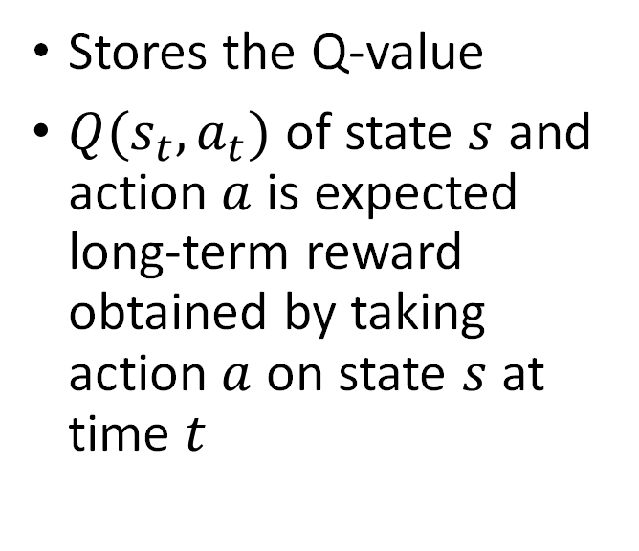
Q-Table
 | Action 1 | Action 2
State 1 | 2 | -0.5
State 2 | -10 | 7
Stores the Q-value
$Q(s_{t},a_{t})$ of state $s$ and action $a$ is expected long-term reward obtained by taking action $a$ on state $s$ at time $t$

Slide 13
Training The Agent
Define Environment
Initialize Q-Table
Exploration
Exploitation
Update Q-Table
Terminate Episode if encounter terminal state

Slide 14
Training Phase
An episode consists of training phase between the start of the agent from initial state to agent ending in any terminal state
Terminal state is either an undesirable state or the final goal state after this step we stop out agent
In a session we train the model for multiple episode so that it explore maximum states and action

Slide 15
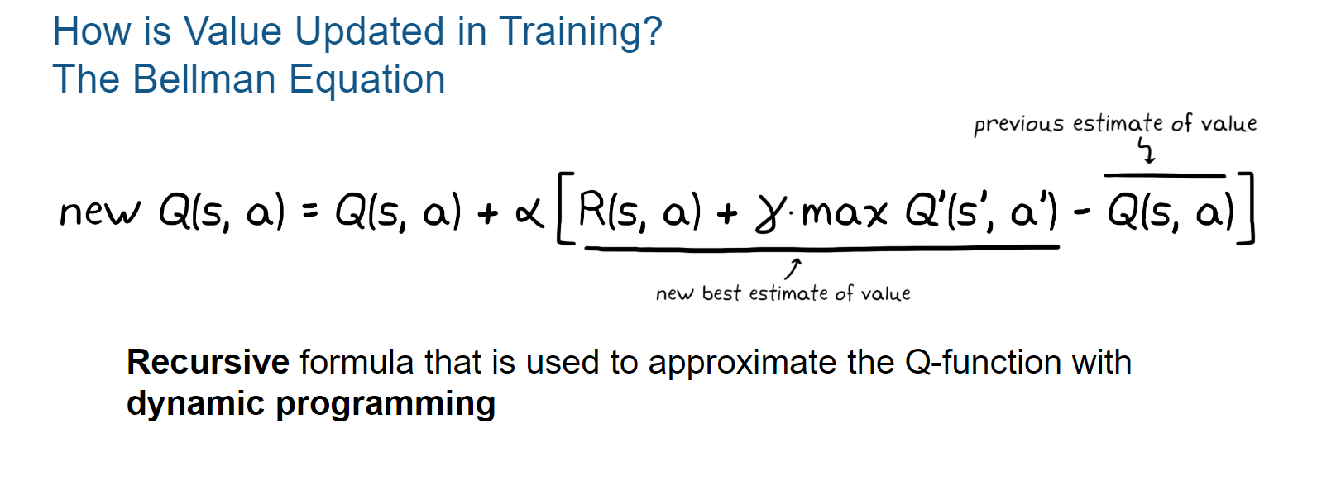
Q-Table Updation
Beakcheol Jang
We don’t know initial value of Q-value so we initialize it with any random value and update the value as agent trains
Source: Beakcheol Jang, Myeoghwi Kim, Gaspard Harerimana, Jong Wook Kim, September 2019

Slide 16
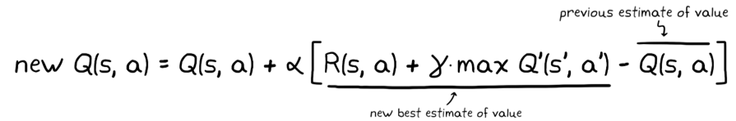
Discount Factor
(Because Current reward better than future rewards)
Learning Rate
(How much updation change old value)
Current Reward
Action 1
State P
Action 1
State M
State Q
Action 1
State X
Action 2
Action 2
State N
State A
Action 2
State R
State Y
Action 3
Action 3
State O
State Z
Action 3

Slide 17
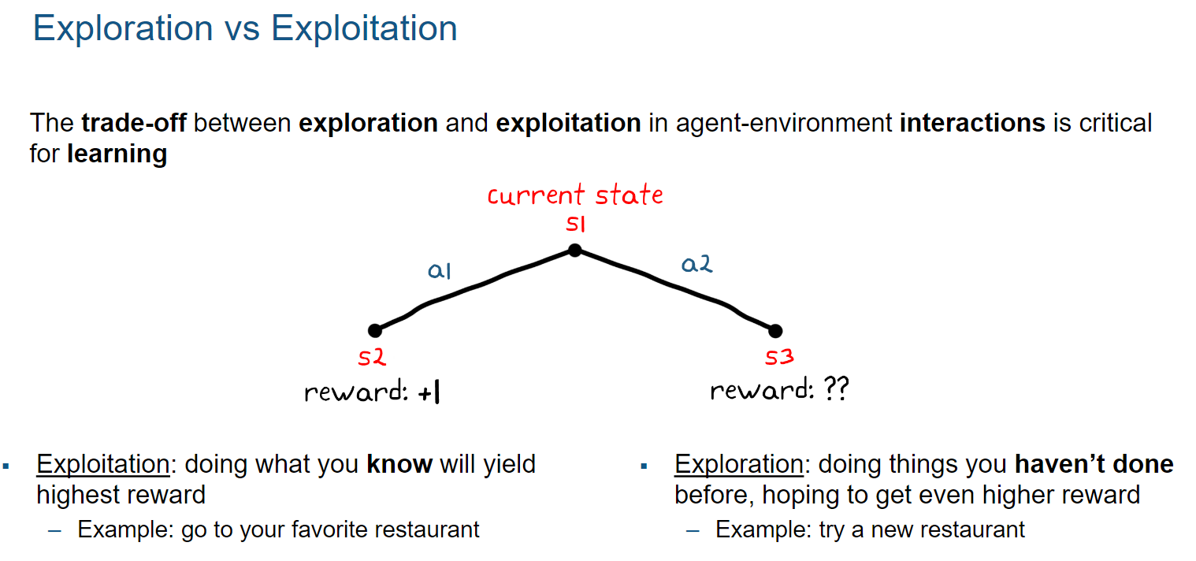

Slide 18
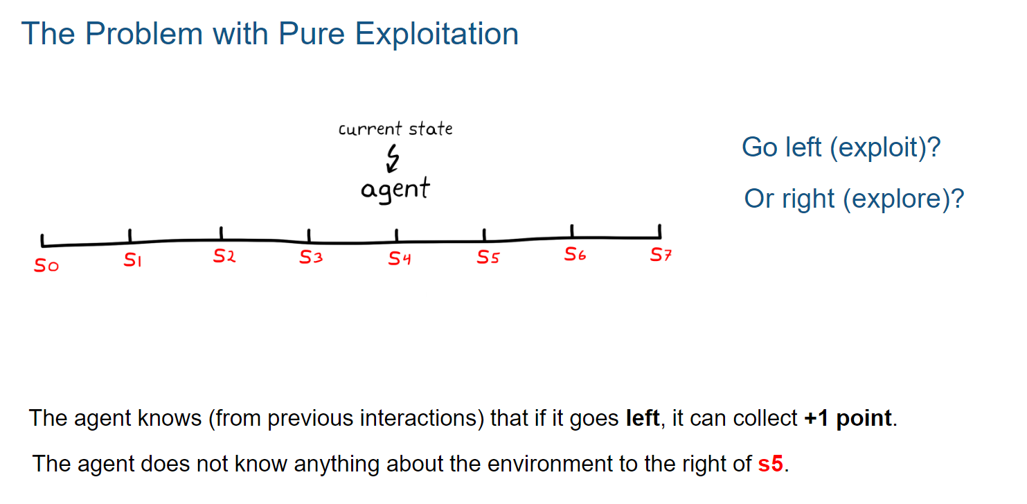

Slide 19
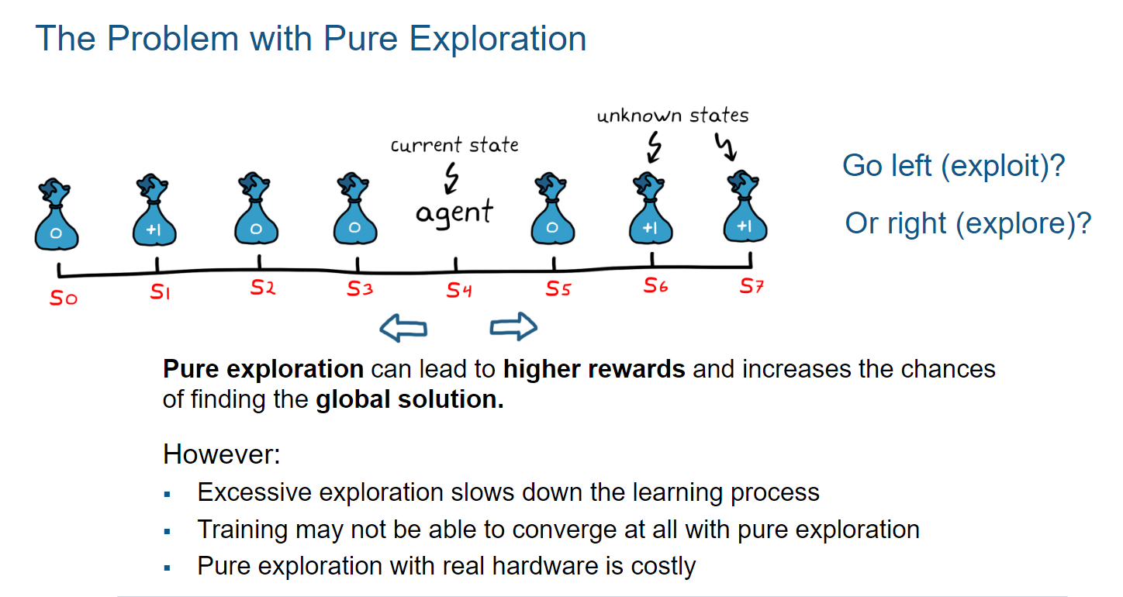

Slide 20
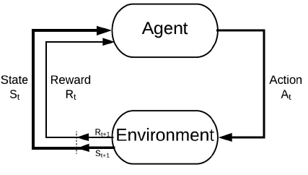
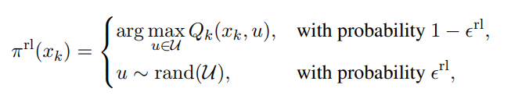
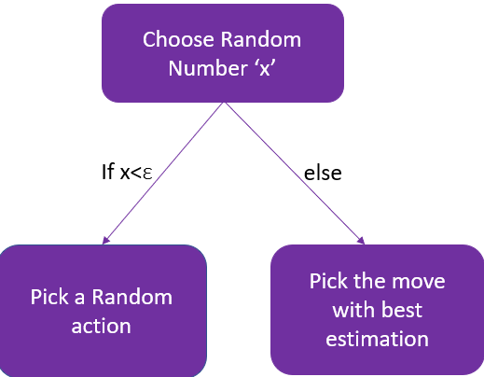
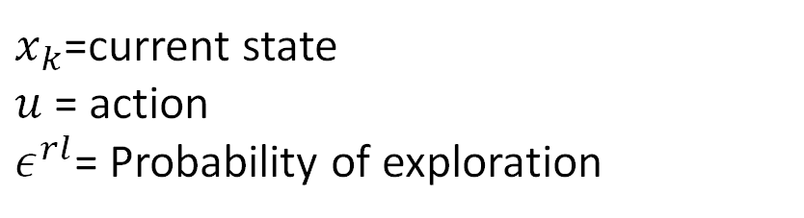
Policy
$x_{k}$=current state $u$= action $ε^{rl}$= Probability of exploration
Q-Table

Slide 21
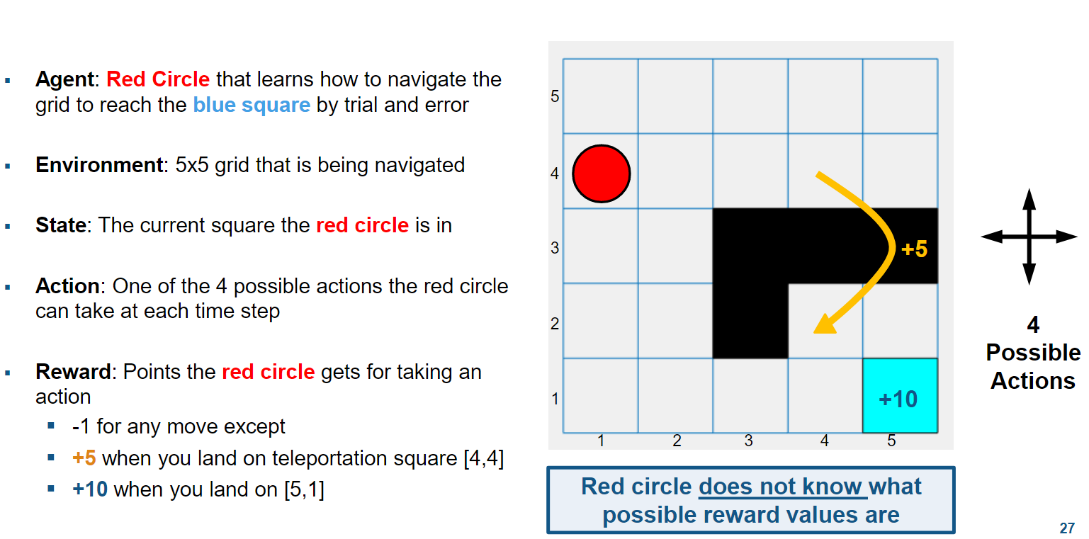

Q-Learning Example

Slide 22
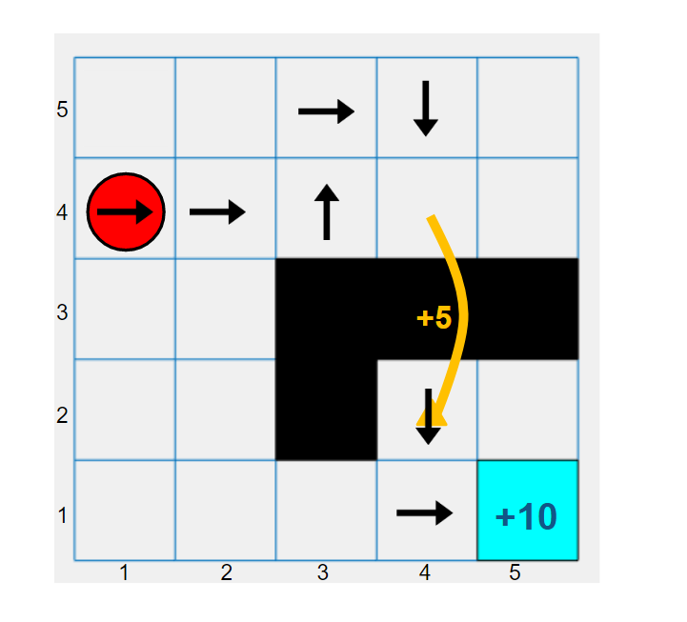
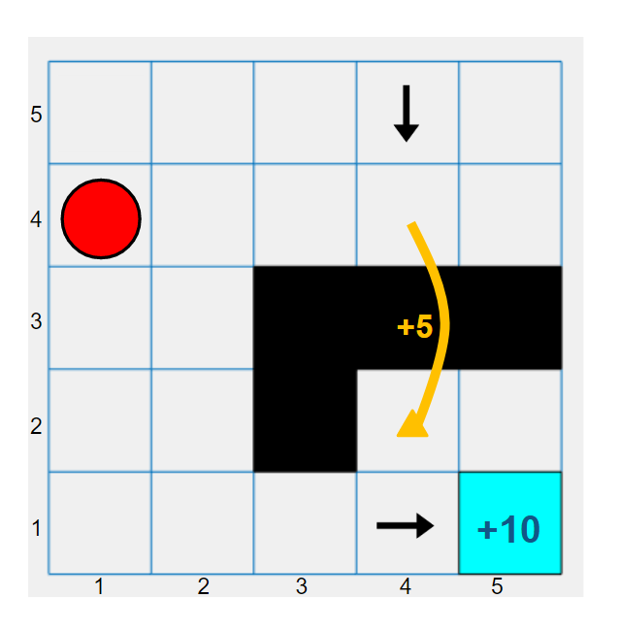
Learning Phase
Agent receive rewards
And it remembers which actions led to reward

Slide 23
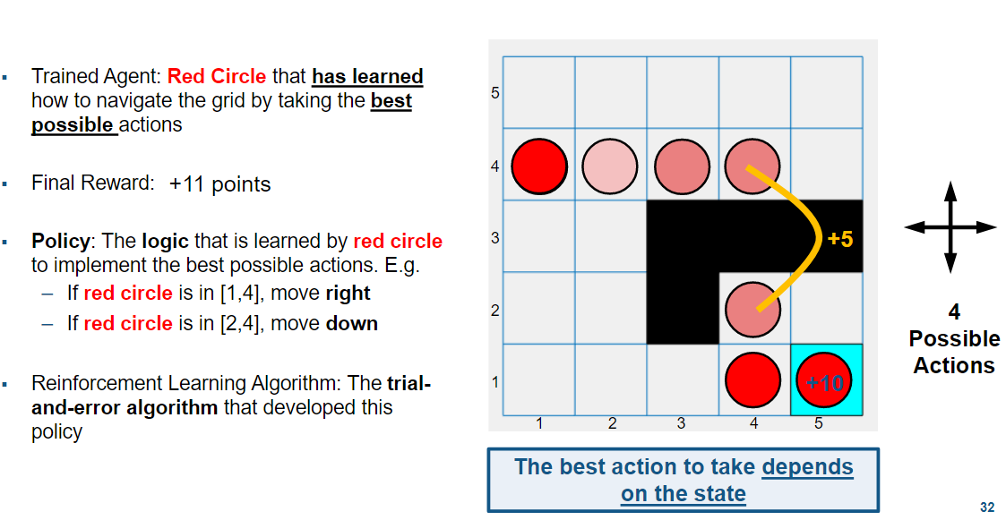

Final Policy

Slide 24
Issues with Control using Classical Q-Learning
Longer training phases
Unsafe situation on failure
Requires a dense discretization
Errors due to function approximation

Slide 25
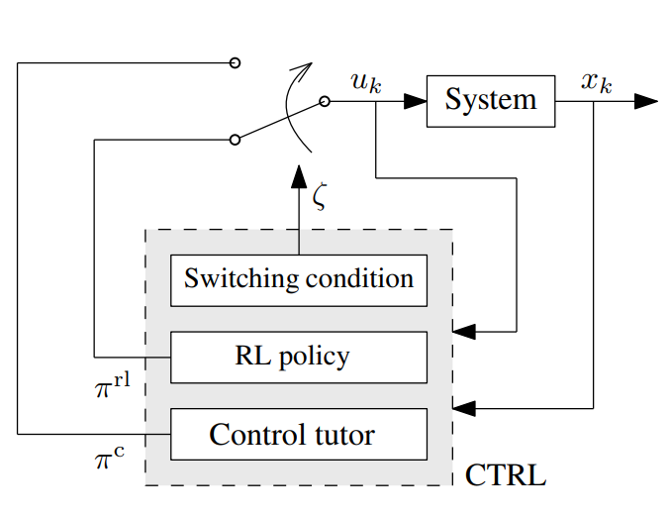
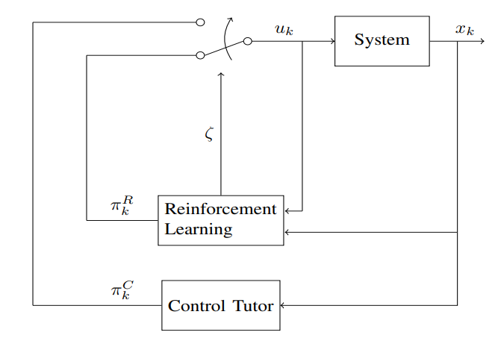
Control-Tutored QL
Added a mathematical model-based control tutor which will help our agent to learn
Whenever the maximum Q-value is negative our tutor will suggest the action to the agent
The suggested action can be exploration or the optimal action from the knowledge of the system
if the later action is not possible for the agent to take it will take the action which is closest to the suggested action

Slide 26
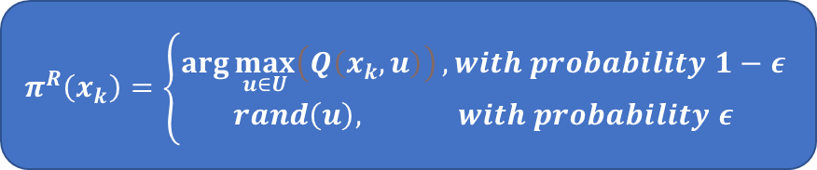
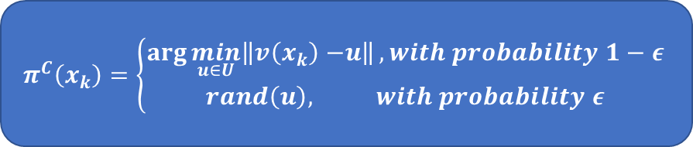
CTQL Demystified
Switching Condition
True
False
Control Policy
RL Policy
x< ε^{c}
else
else
x< ε^{rl}
$$π^{C}\left(x_{k}\right)=\left\{\begin{aligned}\arg{\min_{u∈U}\left\|v\left(x_{k}\right)−\right.\left.u\right\|}, with probability 1−ε \\ &rand\left(u\right), with probability ε\end{aligned}\right.$$
Pick a Random Action
$$π^{R}\left(x_{k}\right)=\left\{\begin{aligned}\arg{\max_{u∈U}\left(Q\left(x_{k},u\right)\right)}, with probability 1−ε \\ &rand\left(u\right), with probability ε\end{aligned}\right.$$

Slide 27
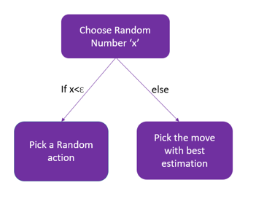
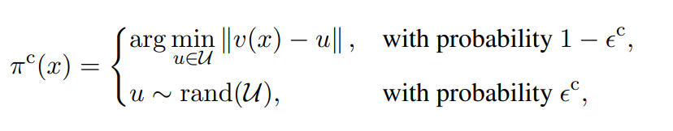
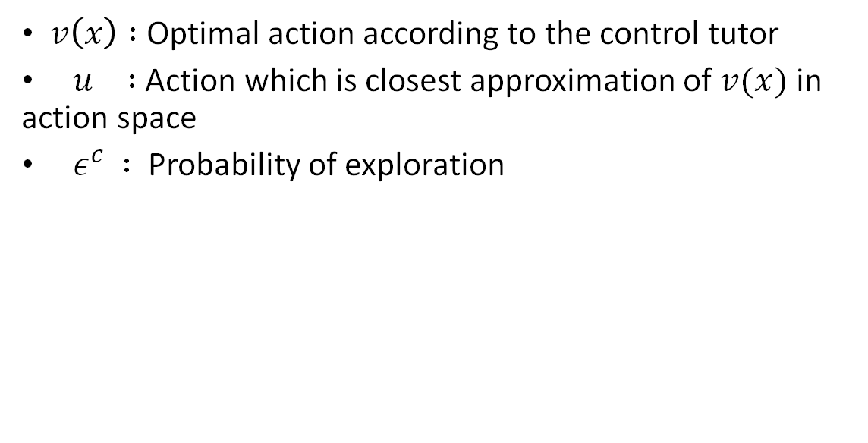
Control Policy
$v\left(x\right) :$ Optimal action according to the control tutor
$u :$ Action which is closest approximation of $v(x)$ in action space
${ ε}^{c} :$Probability of exploration

Slide 28
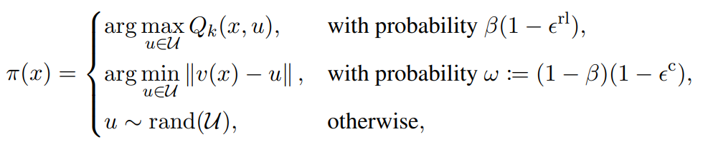
Combined Control-Tutored Policy
x=current state
u = action
ε^{rl} = Probability of exploration for RL policy
ε^{c} = Probability of exploration for Control Policy
β = Switching Probability

Slide 29
Example : Amazon Warehouse
Problem Statement: Find the shortest path from any location to the target location (Packaging Area of the warehouse) for the robot
Agent: Robot
Environment:
State:
Action
Reward
Termination
First using classical Q-Learning and then CTQL

Slide 30
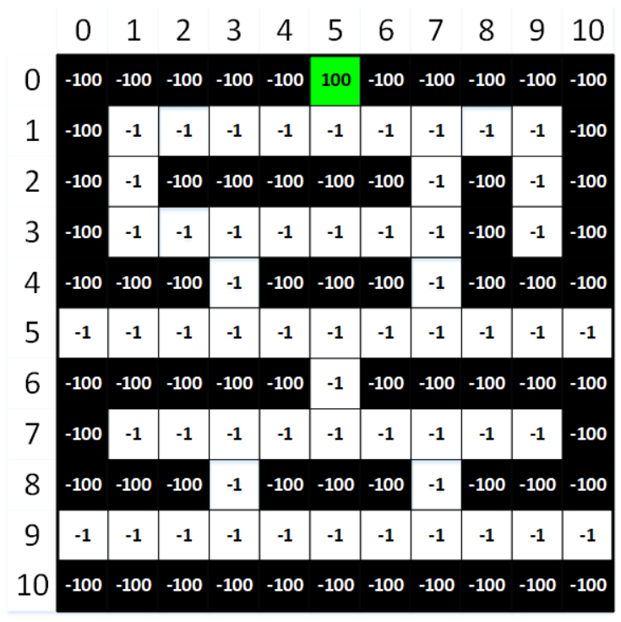
Amazon Warehouse: Environment
Environment:
State: position of the robot in warehouse
Action: Left, Right, Up, Down
Reward :
+100 for the Goal state- Packaging Area
-100 for Restricted Area
-1 for any extra step taken
Termination
Reached Goal state
Reached any restricted area
Accumulate very large negative reward

Slide 31
Amazon Warehouse: Policy
Conventional Q-Learning Policy
With probability ε^{rl} : Action having maximum Q-value
With probability 1- ε^{rl} : choose any random action- Left, Right, Up, Down
Control Tutor Policy
With probability ε^{c}: Choose the most appropriate action to reach the goal state from existing knowledge of the system
With probability 1- ε^{c}, choose any random action- Left, Right, Up, Down
Control Tutor Q-Learning Policy
With probability β: Control Policy
With probability 1-β: Conventional Q-Learning Policy

Slide 32
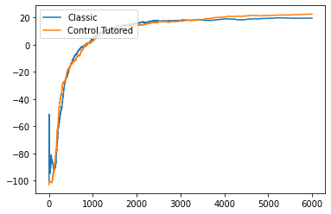
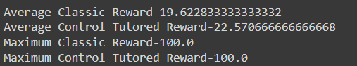
What did we find out?
Comparing Parameter: Average Reward
Average reward tells us about relatively how many optimum and poor decision were made to reach the goal
Higher average reward tells that we took comparatively less poor decisions
Less poor decisions means we took less time to reach the goal
Conclusion: Control-Tutored Q-learning is getting higher average reward

Slide 33
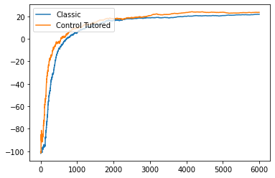
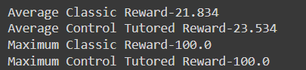

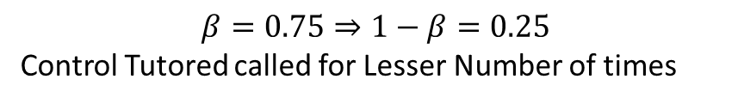
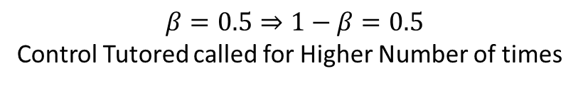
Graph for different switching condition
$$β=0.5⇒1−β=0.5$$
Control Tutored called for Higher Number of times
$$β=0.75⇒1−β=0.25$$
Control Tutored called for Lesser Number of times

Slide 34
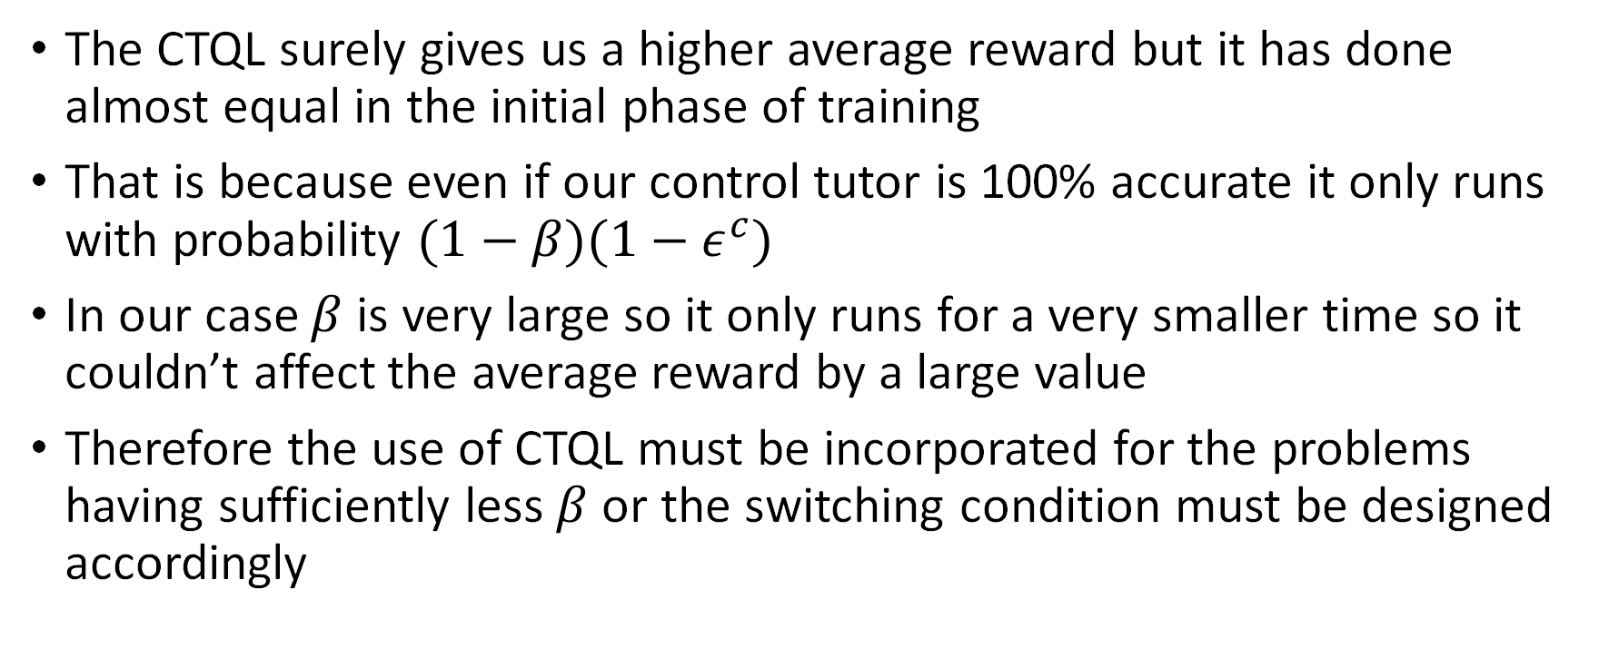
Inference
The CTQL surely gives us a higher average reward but it has done almost equal in the initial phase of training
That is because even if our control tutor is 100% accurate it only runs with probability $(1−β)(1−ε^{c})$
In our case $β$ is very large so it only runs for a very smaller time so it couldn’t affect the average reward by a large value
Therefore the use of CTQL must be incorporated for the problems having sufficiently less $β$ or the switching condition must be designed accordingly

Slide 35
Way Ahead
CTQL on continuous state space and continuous action space
Variation of average reward with switching condition
Performance of CTQL on various control parameters
Performance of CTQL at a different phase of training

Slide 36

Thank You

